Slide 1


SENTIMENT ANALYSER FOR ONLINE EXAM
NAME : BHUVANASRI T
REGISTER NUMBER : 927624BAM006
CLASS : CSE(AIML)
BATCH : I
ACADEMIC YEAR : 2025-2026

Slide 2
PROBLEM STATEMENT
Although online exams address many logistical challenges in education, they create hidden emotional stress among students which is often overlooked. Current feedback systems focus mainly on technical difficulties and exam quality but fail to measure how students actually feel before and after exams. Without analyzing sentiments, educators cannot fully understand the emotional shifts students undergo, such as pre-exam anxiety, post-exam relief, or disappointment, which directly affect learning outcomes and confidence.

Slide 3
.
OBJECTIVES OF THE PROJECT
The main objective of this project is to analyze students’ feedback on online examinations and determine their overall sentiments—whether positive, negative, or neutral.
The project aims to understand students’ emotions and perceptions toward online exams, helping educators identify common challenges, improve exam platforms, and enhance the overall online learning experience.

Slide 4
.
TOOL SELECTION
DATA COLLECTING : Kaggle , Chatgpt , GitHub , Geeksforgeeks
DATA PREPROCESSING: Watson Studio
DATA VISUALIZATION : Watson Studio

Slide 5
.
DATA SOURCE
URL GitHub - google-research-datasets/NewSHead: The NewSHead dataset is a multi-doc headline dataset used in NHNet for training a headline summarization model.
https://www.kaggle.com/datasets/rmisra/news-category-dataset
SAMPLE DATASET
1 | The exam was FAIR & BALANCED | Engineering
2 | Coding part was tough and unclear at Q12 | Arts

Slide 6
.
DATA PREPROCESSING
CLEANING STEPS
The dataset was carefully checked for missing feedback entries and duplicate responses, and such records were removed to maintain data accuracy and reliability.
Each feedback statement was cleaned by removing punctuation marks, numbers, emojis, and unwanted symbols.
REFINED DATASET
Upload the refined dataset file (Excel or CSV) containing student feedback on online exams into IBM Watson Studio and clean the dataset .

Slide 7
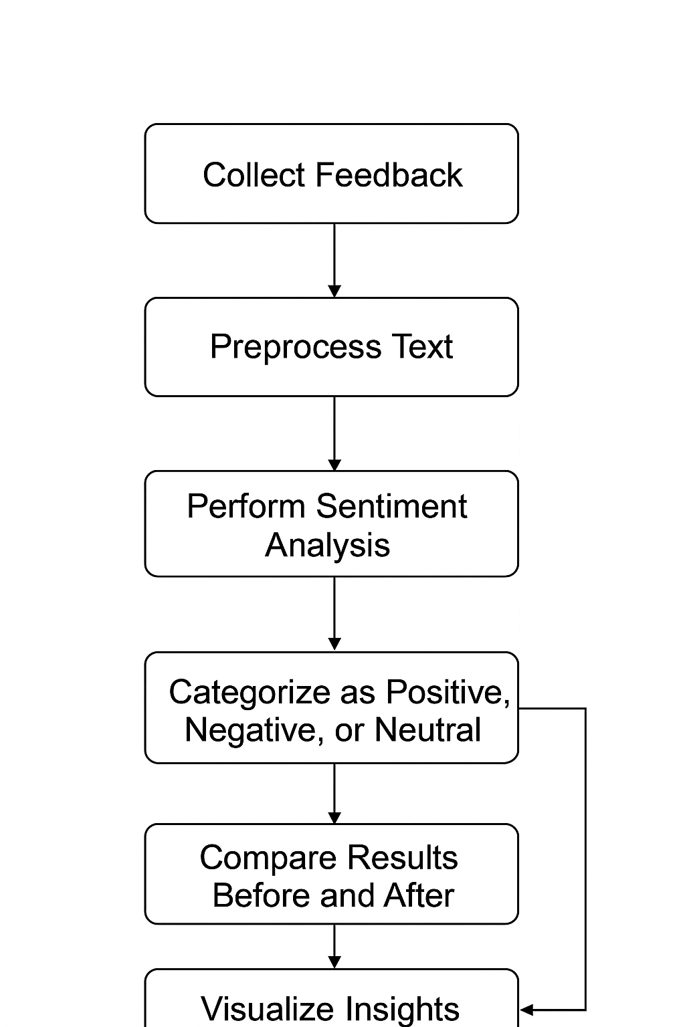
.
Workflow Chart (Data Collection)

Slide 8
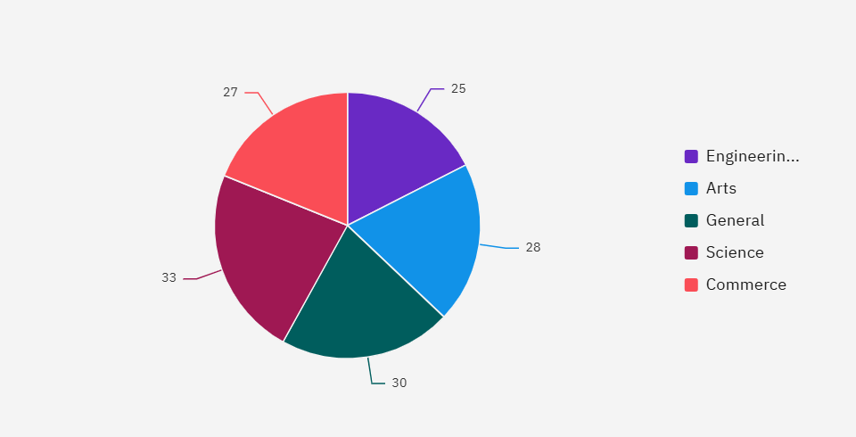
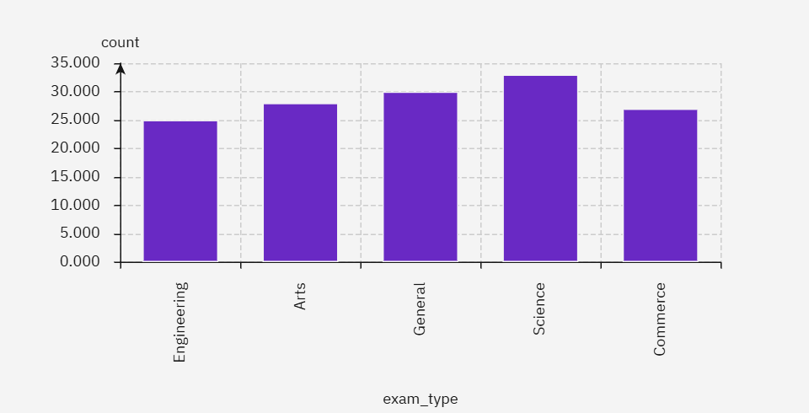
.
IMPLEMENTED VISUALIZATIONS (SCREENSHOTS)

Slide 9
EXISTING AND PROPOSED
Existing System :
In the existing system, student feedback on online exams is collected manually through forms or surveys. The responses are analyzed by teachers, making the process slow and less accurate. There is no automated way to detect positive, negative, or neutral opinions, and overall feedback insights are hard to obtain.---
Proposed System :
The proposed system uses Machine Learning to automatically analyze student feedback. It classifies opinions as Positive, Negative, or Neutral and generates instant reports. This saves time, improves accuracy, and helps administrators quickly understand student satisfaction and improve the online exam process.

Slide 10
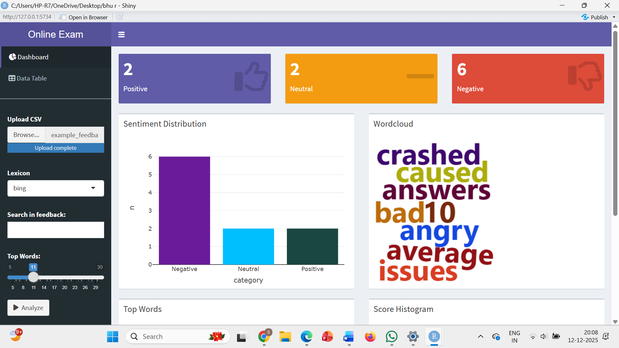
DASHBOARD

Slide 11
ADVANTAGE AND DISADVANTAGE
Advantages :
The system quickly analyzes student feedback and classifies it as positive, negative, or neutral. It saves time, reduces manual effort, and gives accurate insights to improve the online exam process. Real-time reports help teachers understand student satisfaction easily.
Disadvantages :
The system’s accuracy depends on the quality of the dataset. It may misclassify unclear or sarcastic feedback and needs internet access and system resources for processing. Model training also takes time and technical skill.

Slide 12
THANK YOU !

